Slide 1



Hotel
Home
About
Contact
Electronic Hotel Reservation System
AMMAN ARAB UNIVERSITY
Faculty of Information Technology
Systems Analysis and Design
Supervisor : Dr. Marwan Alsed
2024/2025

Slide 2
Hotel
Home
About
Contact
Our Best Team
Noor Diab Omar Sharabati
Raneem Waddah Mahmoud Toumar
Malak Hussam Mohammed Al-Shalabi
Marwa Ahmad Muheimid Al-Naimat
202320137
202320248
202320321
202320991

Slide 3

Hotel
Home
About
Contact
Outlines
Introduction (Abstract)
Problem Statement
Objectives
System Requirements
Functional Requirements
Non-Functional Requirements
Stakeholder Analysis
System Analysis
Use Case Modeling
Domain Class Modeling
System Design
Activity Diagrams
Sequence Diagrams
Design Class Diagram
Conclusion

Slide 4
Hotel
Home
About
Contact
Abstract
•A comprehensive platform for managing hotel operations and enhancing guest experience.
•Solves issues in traditional systems like delays, errors, and inefficiency.
•Key Features:
• Role-based access for different user types.
• Real-time booking and smart device integration.
• Performance dashboards and automated invoicing.
•Developed using Agile methodology with UML modeling.

Slide 5
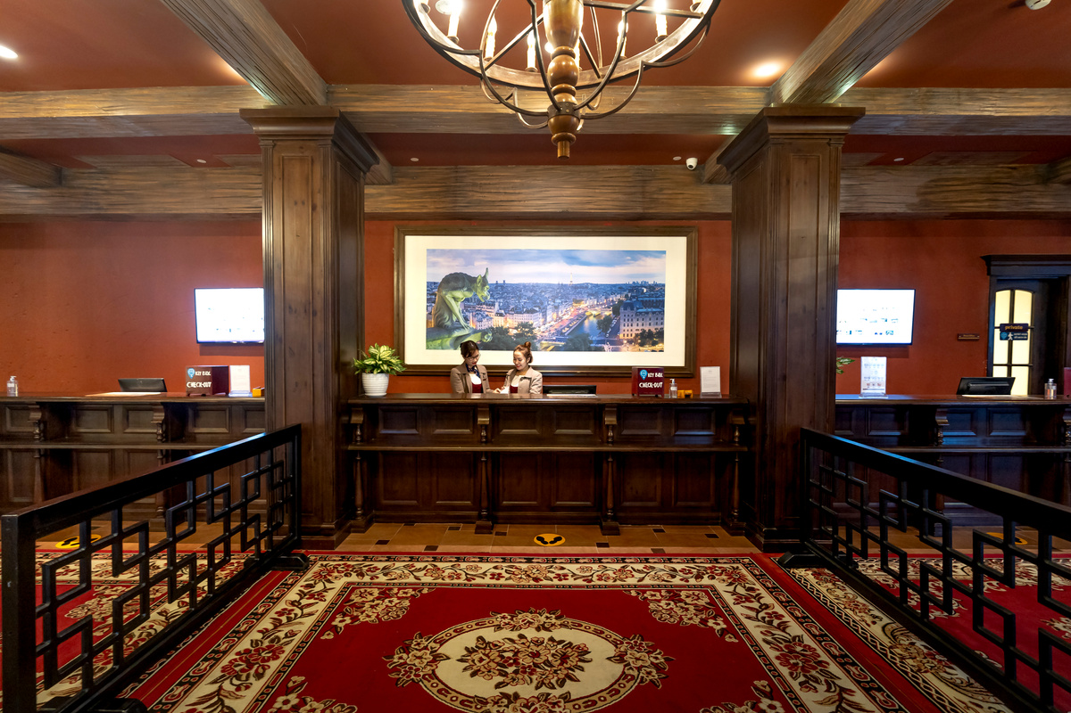

Hotel
Home
About
Contact
Problem Statement
•Traditional hotel systems suffer from:
• Booking delays and poor coordination.
• Manual errors, duplicated data, and room assignment mistakes.
• Dependence on front desk for access and payments.
•These issues reduce guest satisfaction and competitiveness.

Slide 6
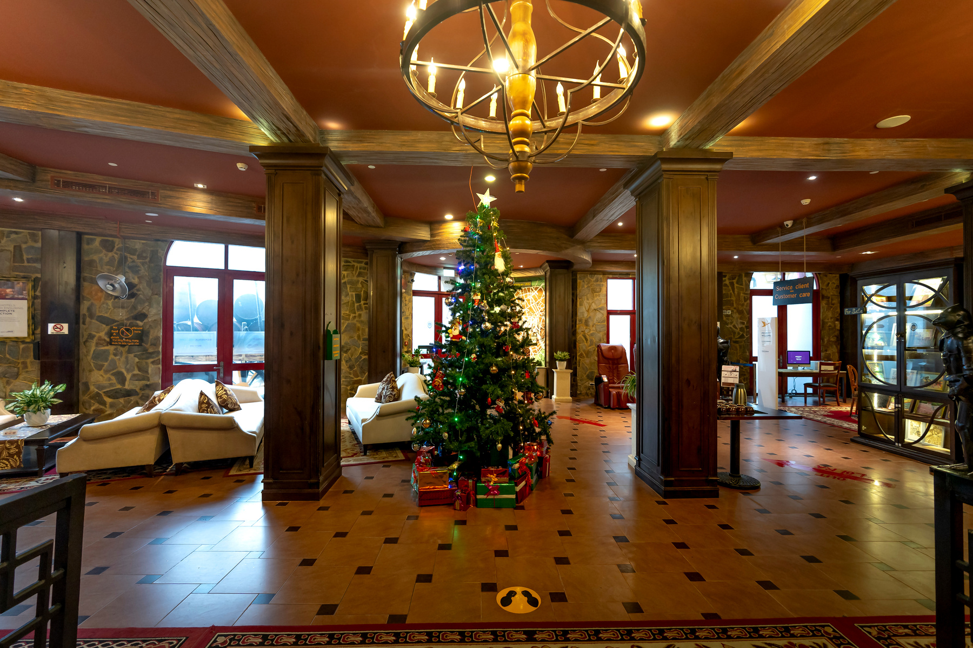
Hotel
Home
About
Contact
Objectives
• Unify operations under one system.
•Automate room preparation and guest services.
• Support for personalized guest requests.
•Enable analytics and smart device integration.

Slide 7
Hotel
Home
About
Contact
Functional Requirements
•1. User registration and login
•2. Room search and real-time availability
•3. Booking and payment handling
•4. Manage bookings and send access codes
•5. Staff tools for updates and tasks
•6. Reports, analytics, and notifications

Slide 8
Hotel
Home
About
Contact
Non-Functional Requirements
•Performance: < 2s response time
• Scalability: handles high user load
• Security: encryption and compliance
• Availability: 99.9% uptime
• Usability: intuitive UI
• Maintainability and Compatibility
• Localization support

Slide 9



Hotel
Home
About
Contact
Stakeholders
•Guests: Booking, payments, room access
•Front Desk: Manage bookings and coordinate tasks
•Housekeeping: Clean and prepare rooms
•Manager: Monitor performance and reports
•Finance: Handle invoices and payments

Slide 10
Hotel
Home
About
Contact
Use Case Diagram
•This diagram represents all actors and their interactions with the system.
•Includes: Guest, Front Desk, Housekeeping, Manager, Finance.

Slide 11

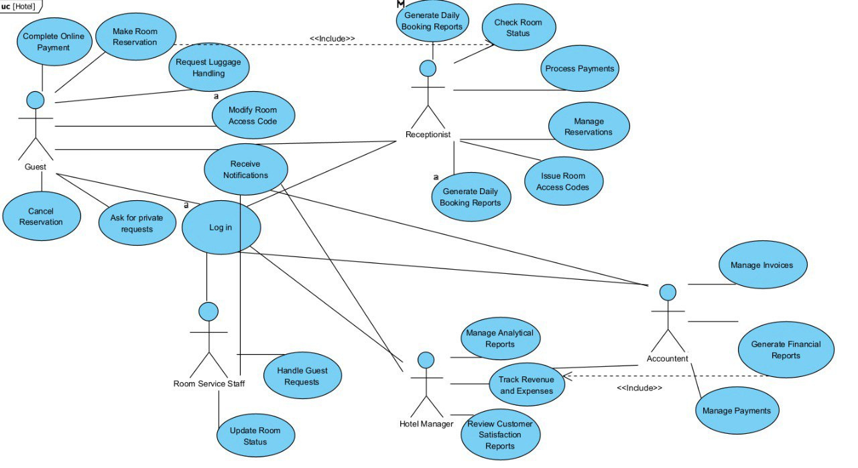
Hotel
Home
About
Contact
Use Case Diagram

Slide 12
Hotel
Home
About
Contact
Example Use Case: Cancel Reservation
•Actor: Guest
•Scenario: Guest cancels a previously made reservation.
•Flow:
•1. Guest logs in and selects a reservation.
•2. System displays details and cancel option.
•3. Guest confirms; system updates status and sends confirmation.
•Exceptions:
• Cannot cancel after check-in date.
• Errors if session times out or system fails.

Slide 13
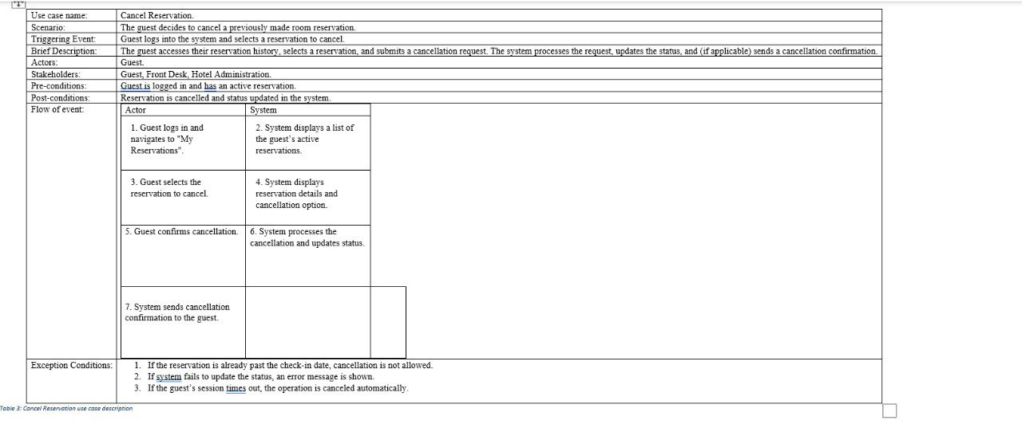
Hotel
Home
About
Contact
Example Use Case: Cancel Reservation

Slide 14
Hotel
Home
About
Contact
Domain Class Diagram
•Shows the key system classes and their attributes.
•Examples: Customer, Room, Reservation with attributes.

Slide 15
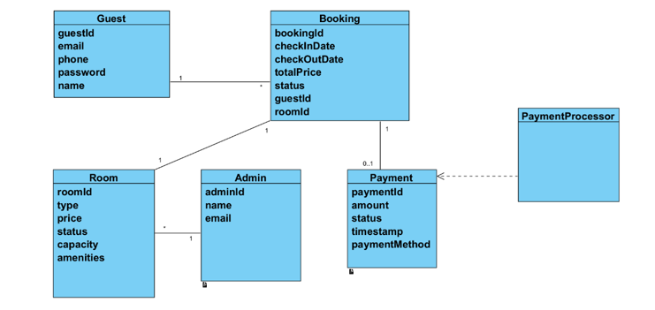
Hotel
Home
About
Contact
Domain Class Diagram

Slide 16
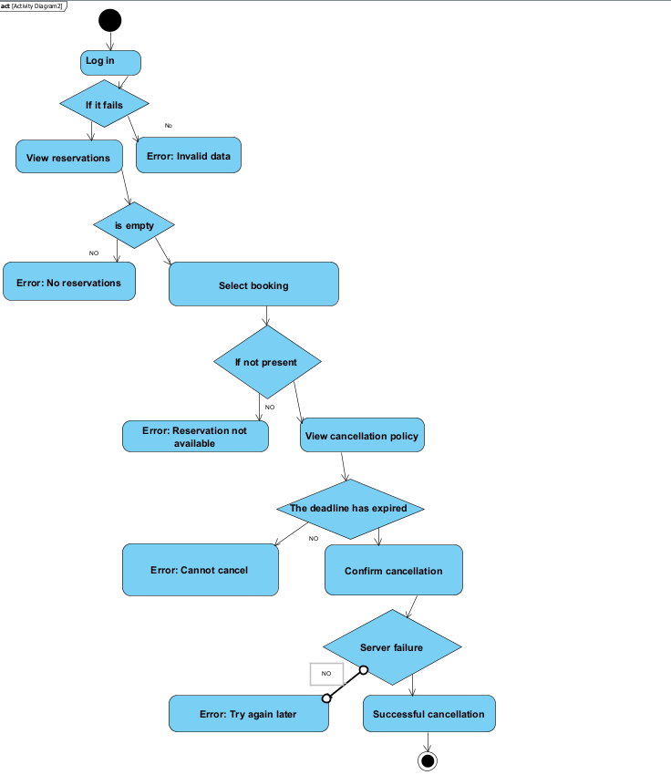
Hotel
Home
About
Contact
Example Activity Diagram: Cancel Reservation
•Actor: Guest
•1. Guest logs in and navigates to "My Reservations".
•2. System displays a list of the guest’s active reservations.
•3. . Guest selects the reservation to cancel.
•4. System displays reservation details and cancellation option.
•5. Guest confirms cancellation.
•6. System processes the cancellation and updates status.
•7. System sends cancellation confirmation to the guest.

Slide 17
Hotel
Home
About
Contact
System Sequence Diagram:
Class Diagram
•Actor: Guest
•Scenario: The guest decides to cancel a previously made room reservation.
•1. Guest logs in and navigates to "My Reservations".
•2. System displays a list of the guest’s active reservations.
•3. . Guest selects the reservation to cancel.
•4. System displays reservation details and cancellation option.
•5. Guest confirms cancellation.
•6. System processes the cancellation and updates status.
•7. System sends cancellation confirmation to the guest.

Slide 18
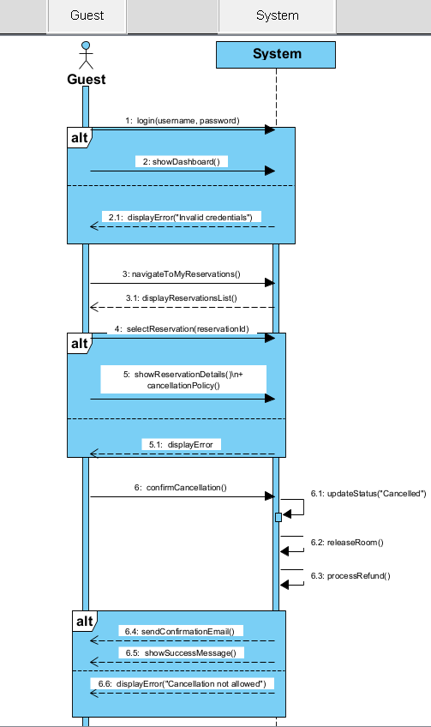
Hotel
Home
About
Contact
System Sequence Diagram:
Cancel Reservation

Slide 19
Hotel
Home
About
Contact
Design Class Diagram
•Represents the detailed system structure with attributes and methods.
•Includes: Room, Reservation, Payment, User, etc.

Slide 20
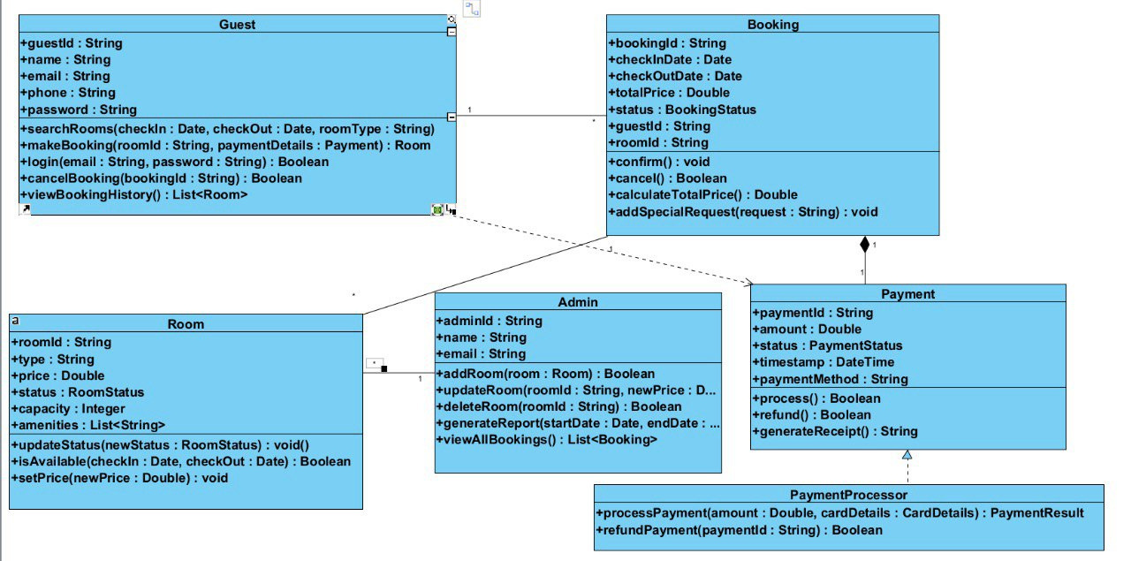
Hotel
Home
About
Contact
Design Class Diagram

Slide 21
Hotel
Home
About
Contact
Conclusion
• Improves guest satisfaction and operational efficiency.
•Reduces manual errors and waiting time.
• Enables modern, smart hospitality services.
• Provides data for informed decision-making.

Slide 22
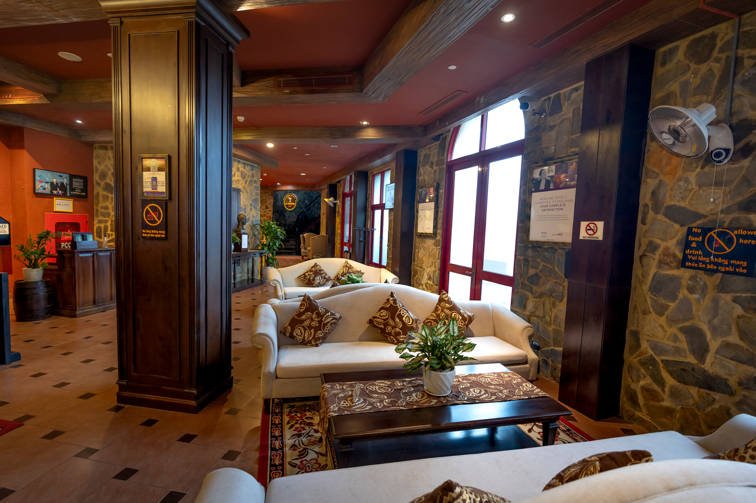
Hotel
Home
About
Contact
Thank You
FOR YOUR ATTENTION

